Slide 1

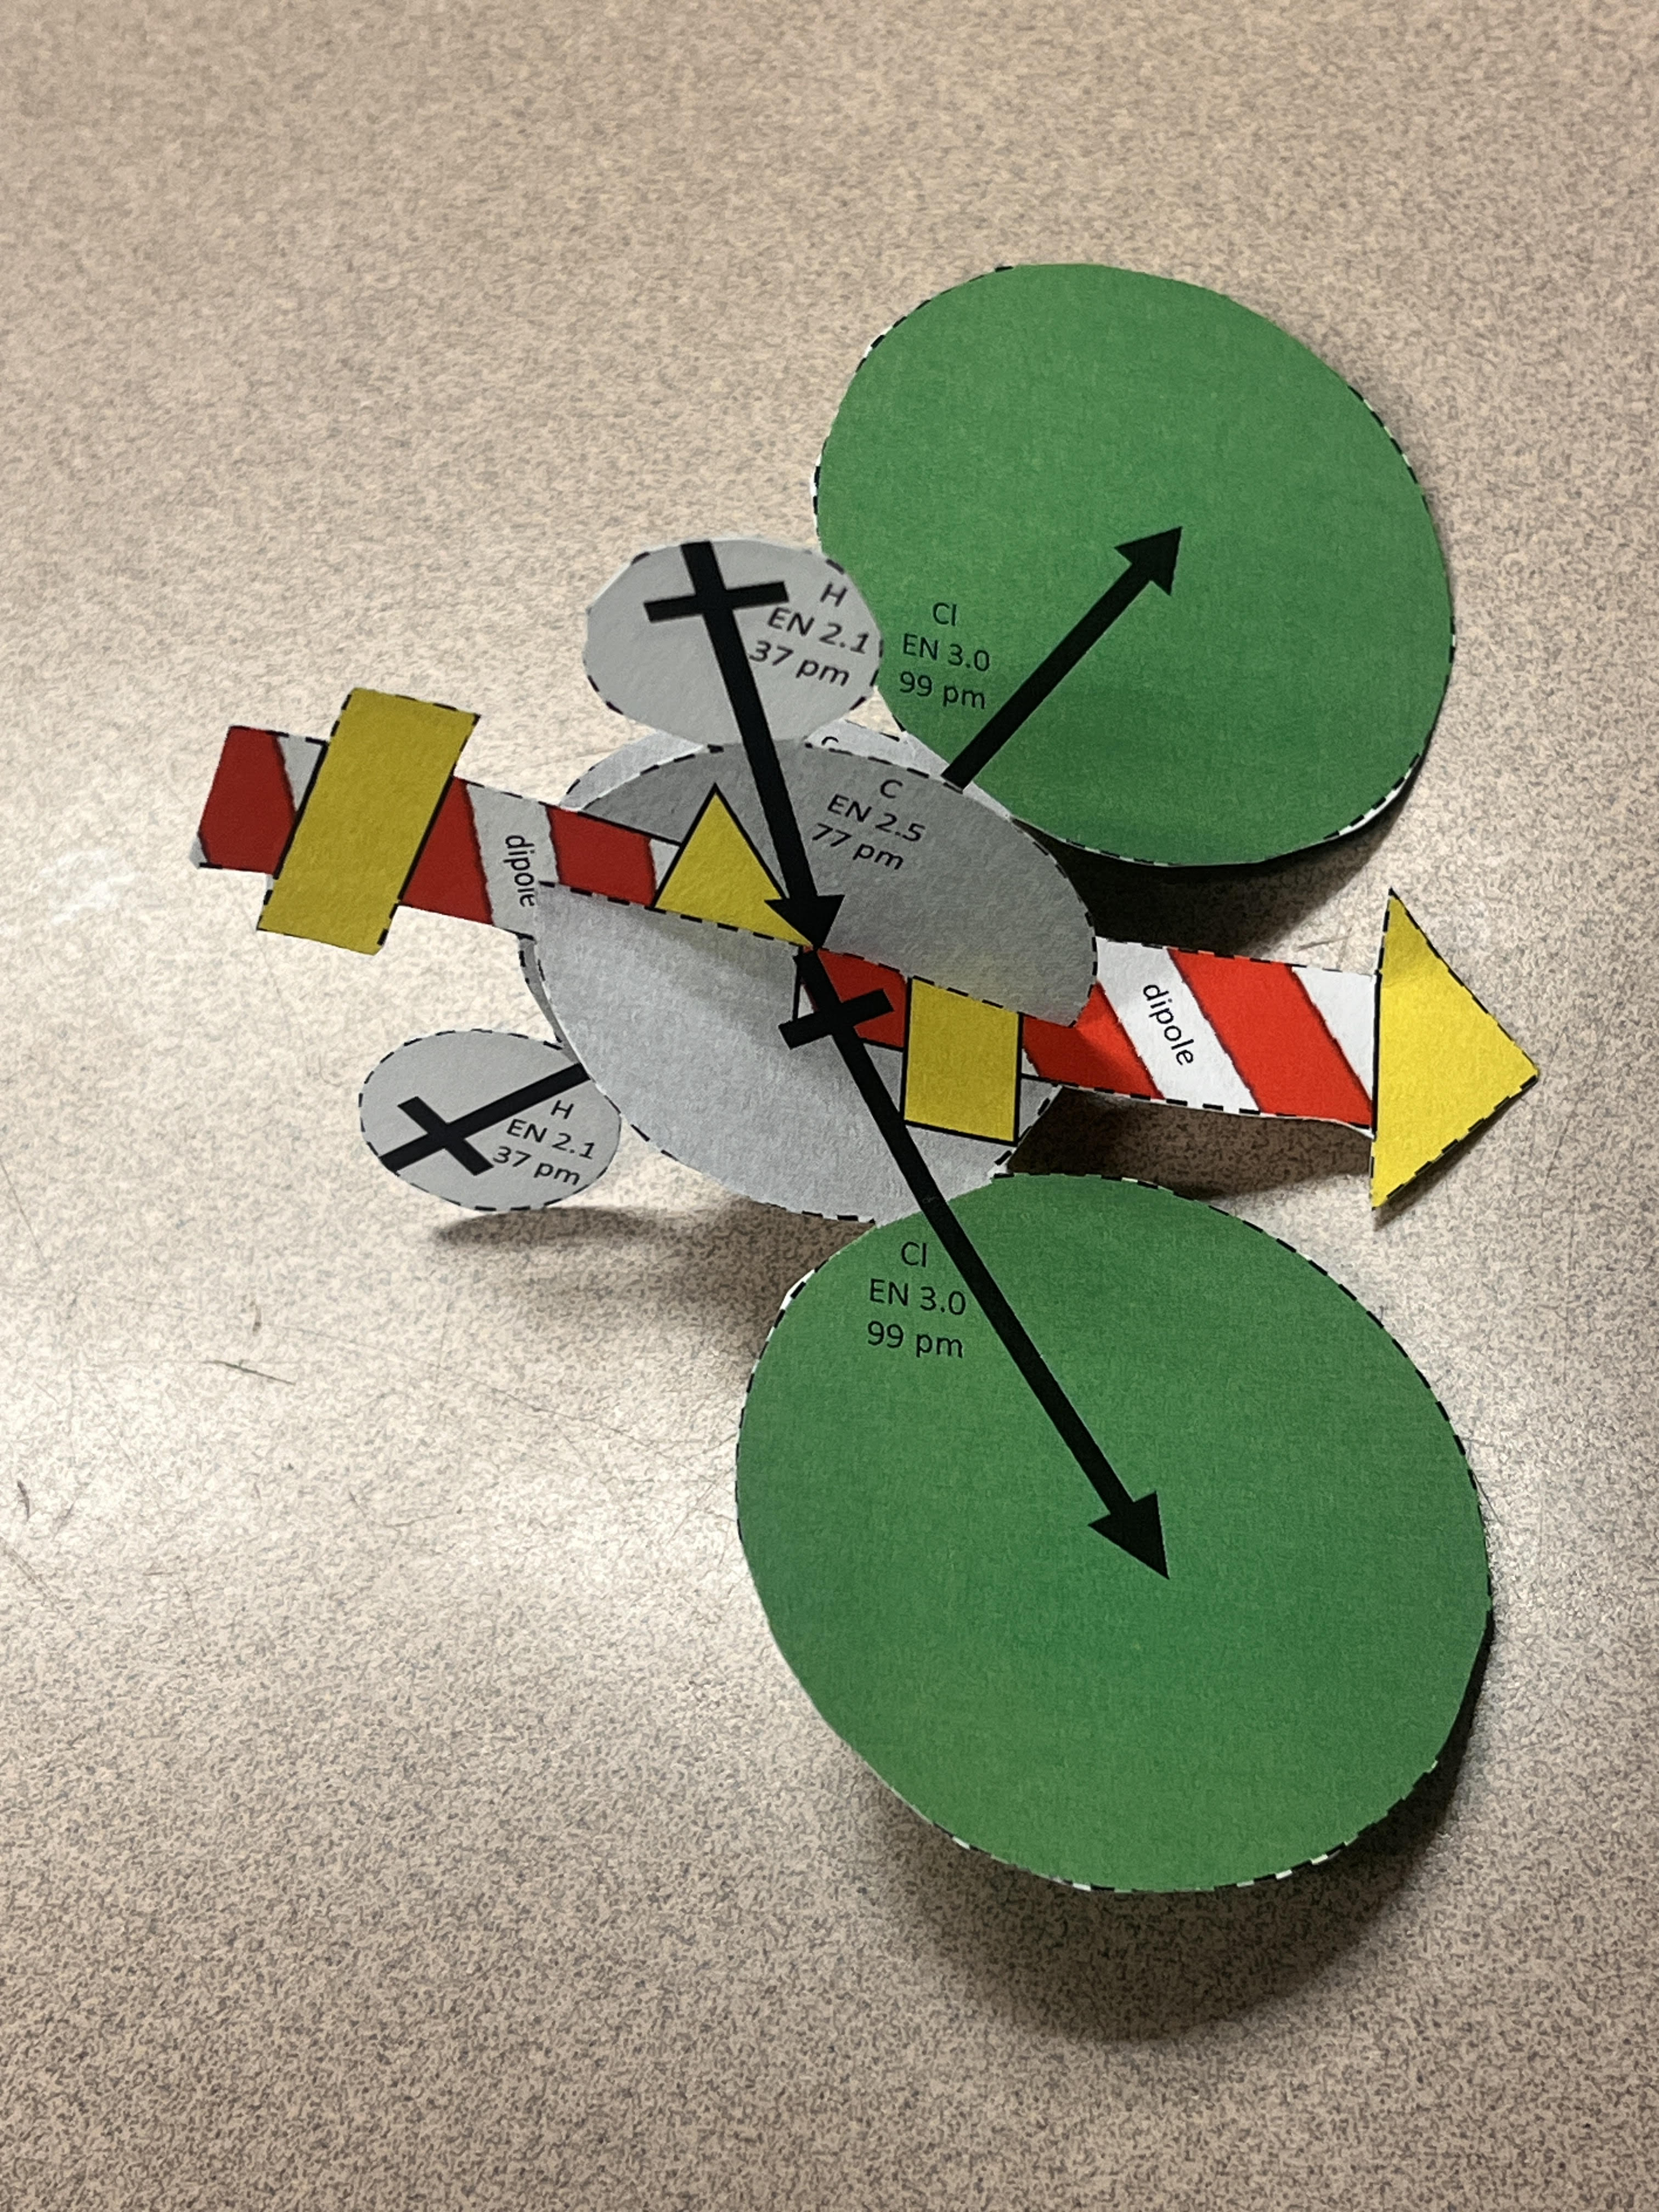
You can cut out and assemble this North Pole-ar molecular model
By Dean Campbell, Bradley University
H
EN 2.1
37 pm
Cl
EN 3.0
99 pm
C
EN 2.5
77 pm
C
EN 2.5
77 pm
dipole
dipole
H
EN 2.1
37 pm
Cl
EN 3.0
99 pm
Print double sided and cut along dashed lines
Slide the notches of the halves together to model a tetrahedral molecule with electric dipole
You can cut out and assemble this North Pole-ar molecular model
By Dean Campbell, Bradley University
H
EN 2.1
37 pm
Cl
EN 3.0
99 pm
C
EN 2.5
77 pm
C
EN 2.5
77 pm
dipole
dipole
H
EN 2.1
37 pm
Cl
EN 3.0
99 pm
Print double sided and cut along dashed lines
Slide the notches of the halves together to model a tetrahedral molecule with electric dipole

Slide 2
H
EN 2.1
37 pm
Cl
EN 3.0
99 pm
C
EN 2.5
77 pm
C
EN 2.5
77 pm
H
EN 2.1
37 pm
Cl
EN 3.0
99 pm
H
EN 2.1
37 pm
Cl
EN 3.0
99 pm
C
EN 2.5
77 pm
C
EN 2.5
77 pm
H
EN 2.1
37 pm
Cl
EN 3.0
99 pm

